Slide 1

SUBMITTED TO: MA’AM RABEA JAFFARI
PRESENTED BY: ZAHEER(077), MUZAMIL(074), TUFAIL(071), AISHA(017)

Slide 2
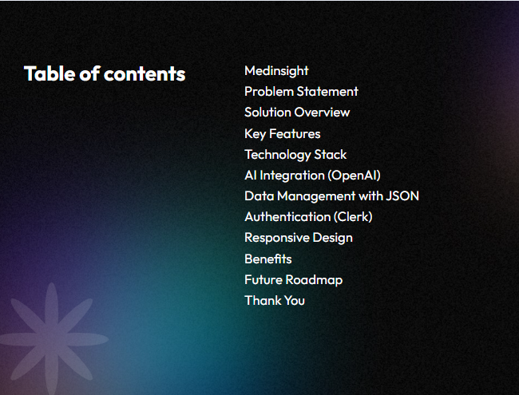
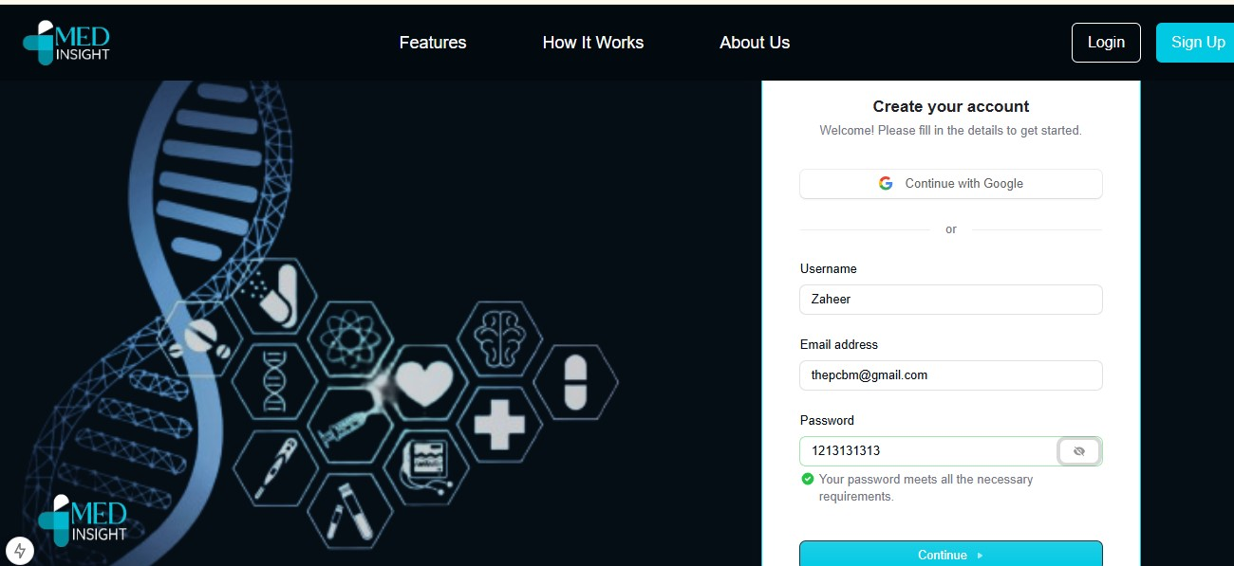

Slide 3
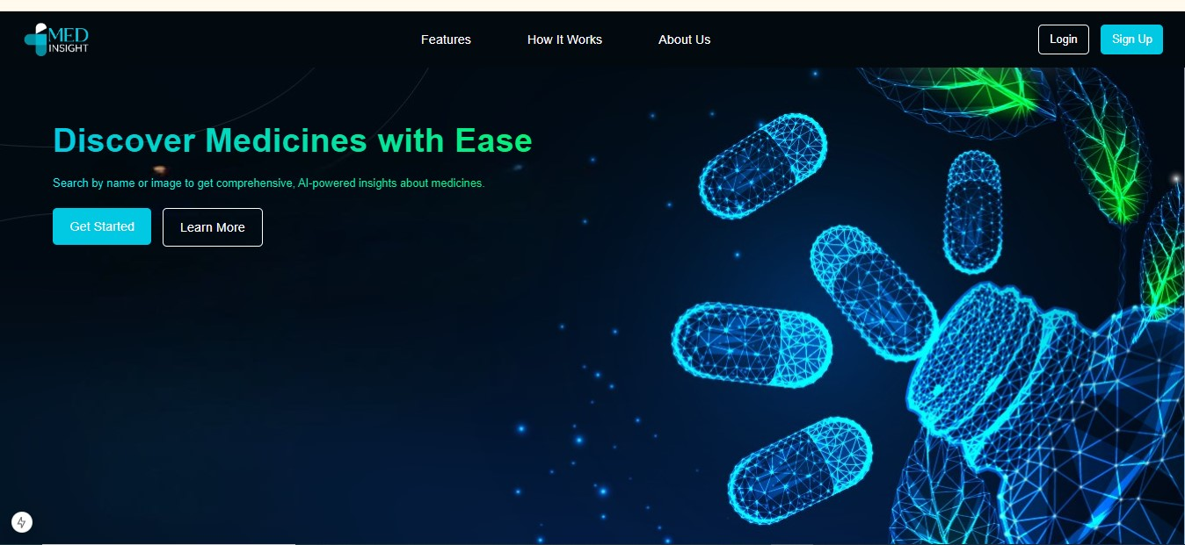
MedInsight: AI-Powered Medicine Information Platform
Your Smart Guide to Pharmaceutical Knowledge

Slide 4
Problem Statement
- Lack of centralized medicine information
- Difficulty accessing reliable drug details
- Limited digital tools for patients and professionals

Slide 5
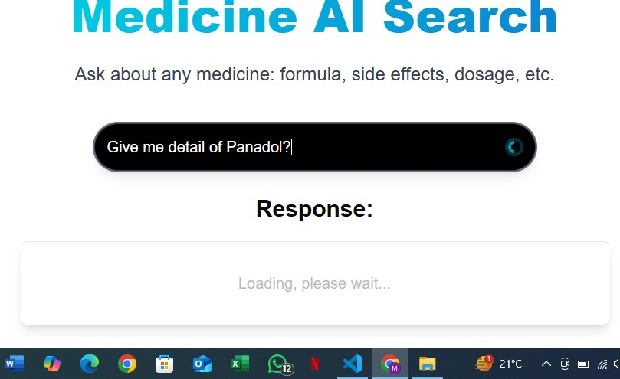
Solution Overview
- MedInsight: AI-powered web app
- Instant medicine database access
- AI-based medical query resolution
- Trusted source for healthcare providers & patients

Slide 6
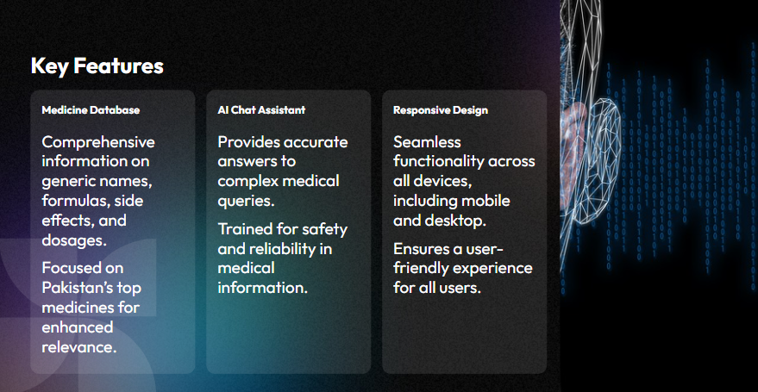

Slide 7
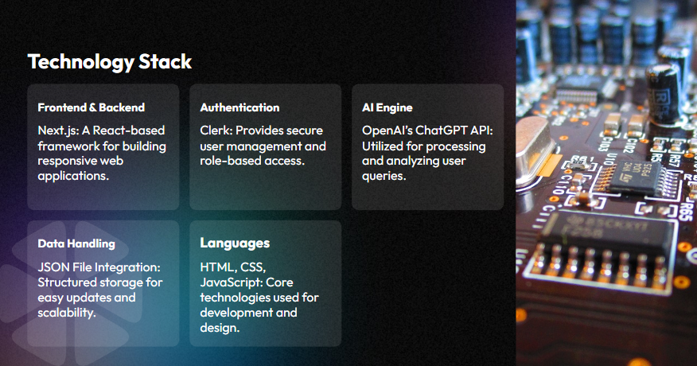

Slide 8
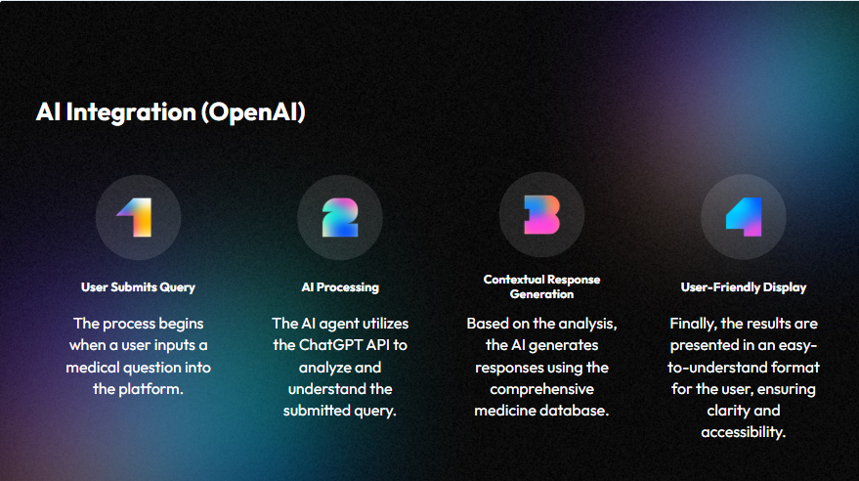

Slide 9
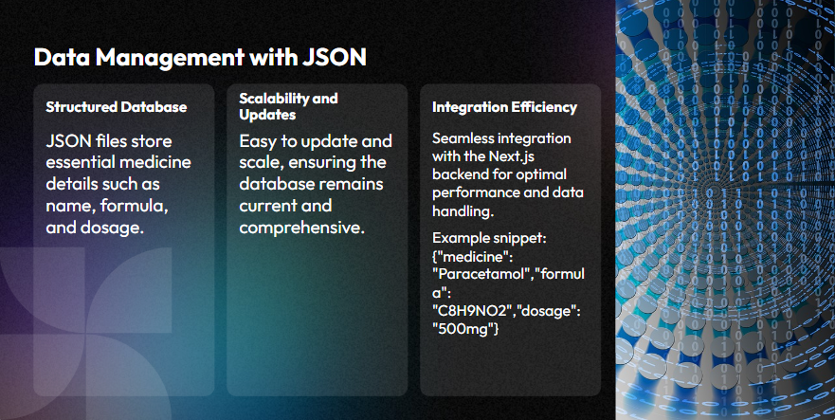

Slide 10
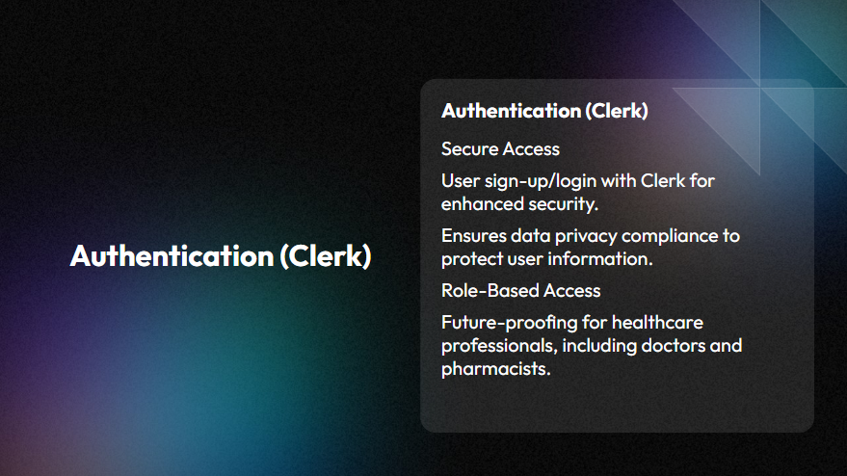

Slide 11
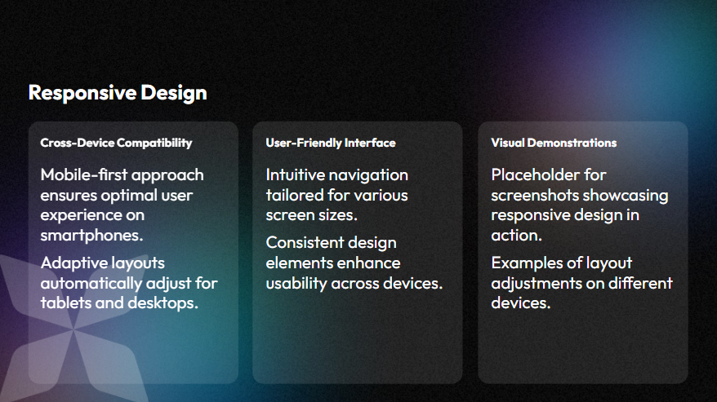

Slide 12
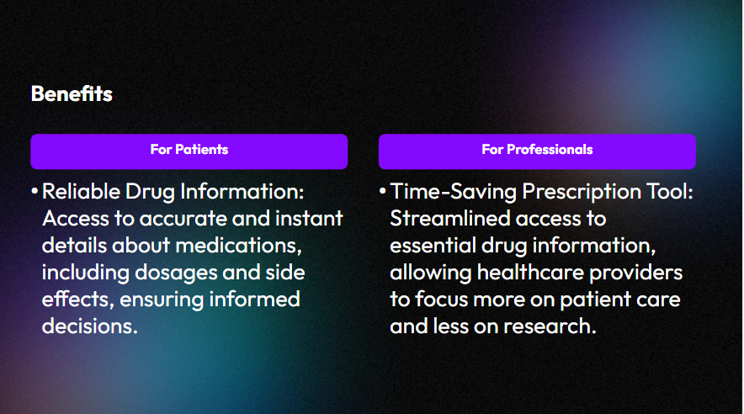

Slide 13
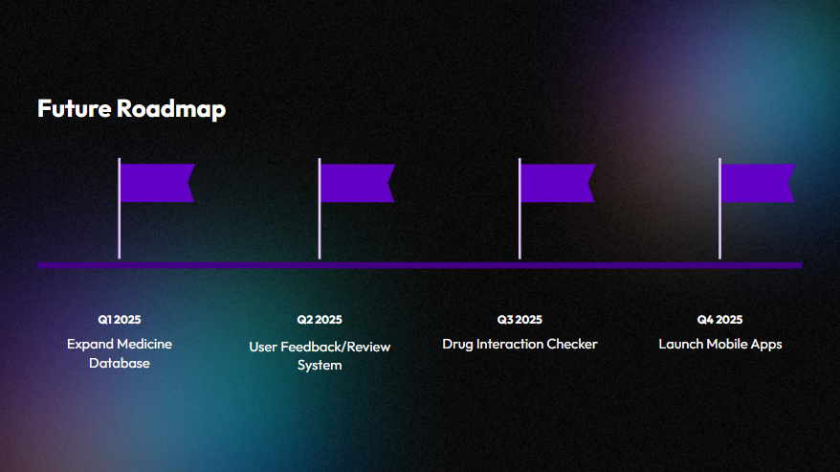

Slide 14
